Slide 1
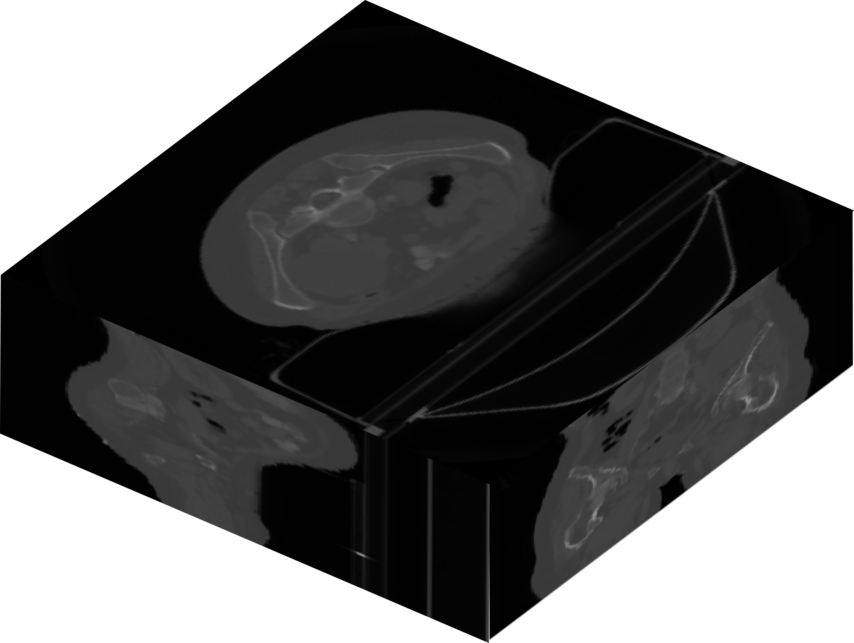
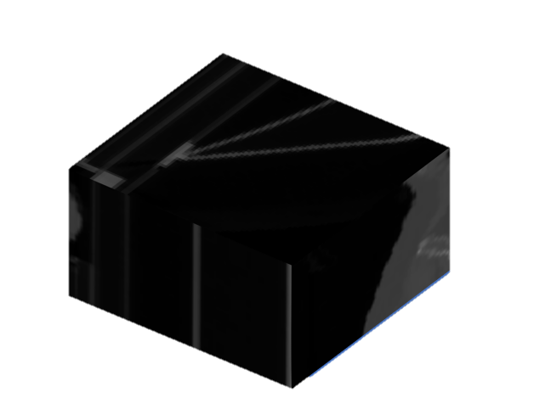
X/Y/Z slicing
Slice

Slide 2
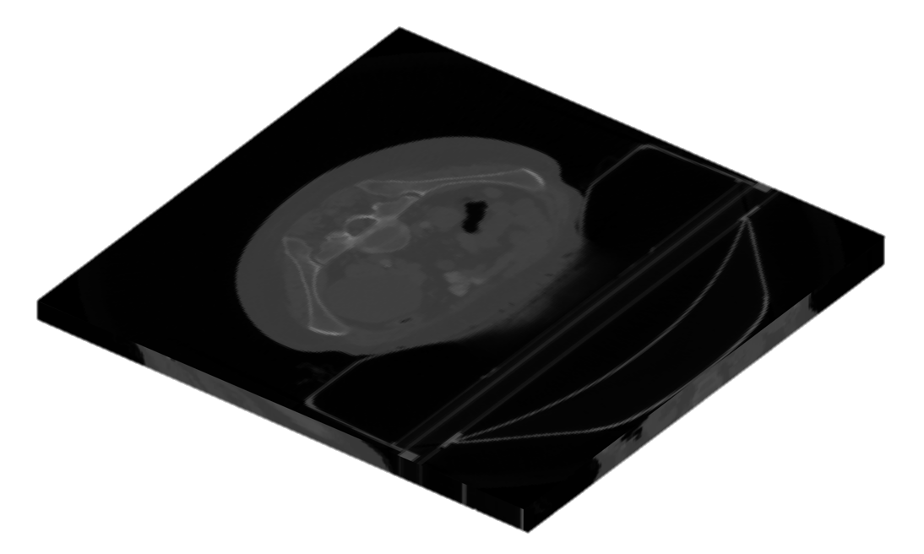
Z-only slicing
Slice

Slide 3

Sliced Output
Output
Sliced Input
Input
Model

